Slide 1
HR Analytics Classification
A Data Science Classification Project on
Team
18th September, 2021

Slide 2
Team Members
Oladimeji Williams (Team Lead)
Mesoma Egwuekwe (Data sourcing)
Oluyoyin Emmanuel (Data sourcing)
Fashola Taiwo Olufunke (PPT preparation)
Olasunkanmi Ogunniyi
Israel Okanlawon
Nicholas Ishola
Monsur Obikoya
Omotoyinbo Oluwadunsin
Nwokeohuru Chijindu
Nnaemeka Ozuzuma
Adesoba Adewale Olamide
Oyalude Oluwajuwon
Liberty Mdaya

Slide 3
Problem Statement
Build a model to identify the potential employees that will be promoted after an evaluation process.
Deploy the model

Slide 4
Model Pipeline
Data Sourcing
Data Preparation
Model Training
Model Evaluation and Validation
Model Deployment

Slide 5
Data Source
https://www.kaggle.com/bhrt97/hr-analytics-classification

Slide 6
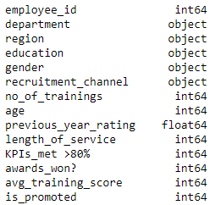
Data Preparation

Slide 7
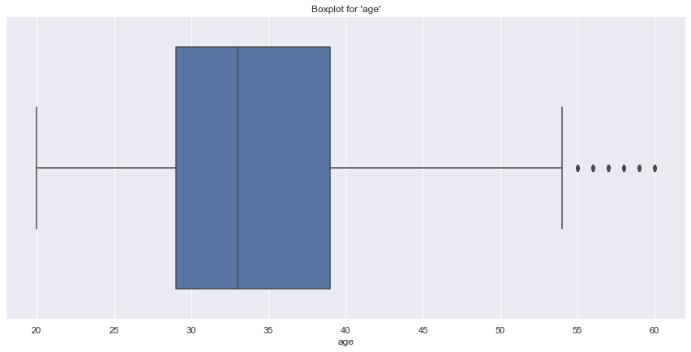

Slide 8
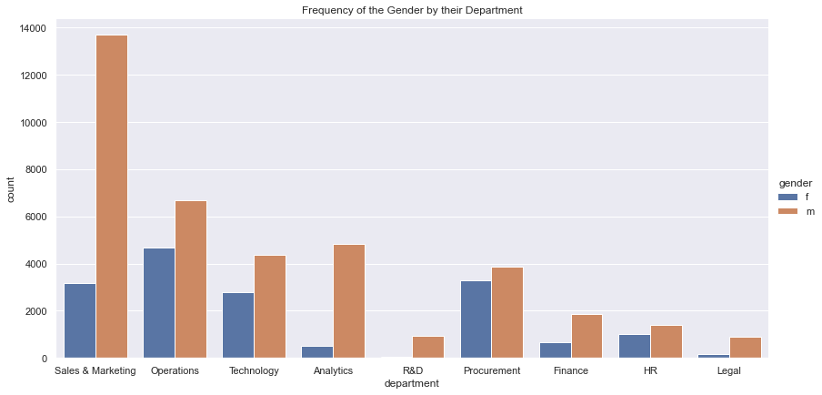

Slide 9
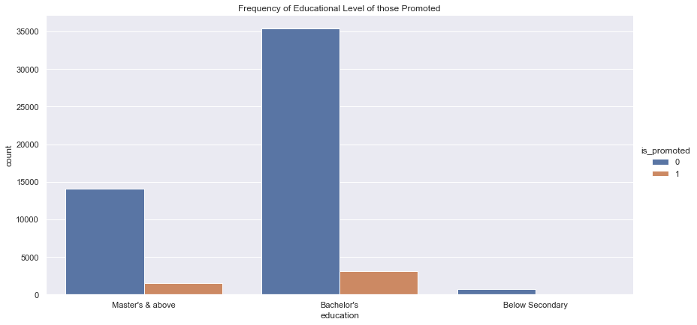

Slide 10
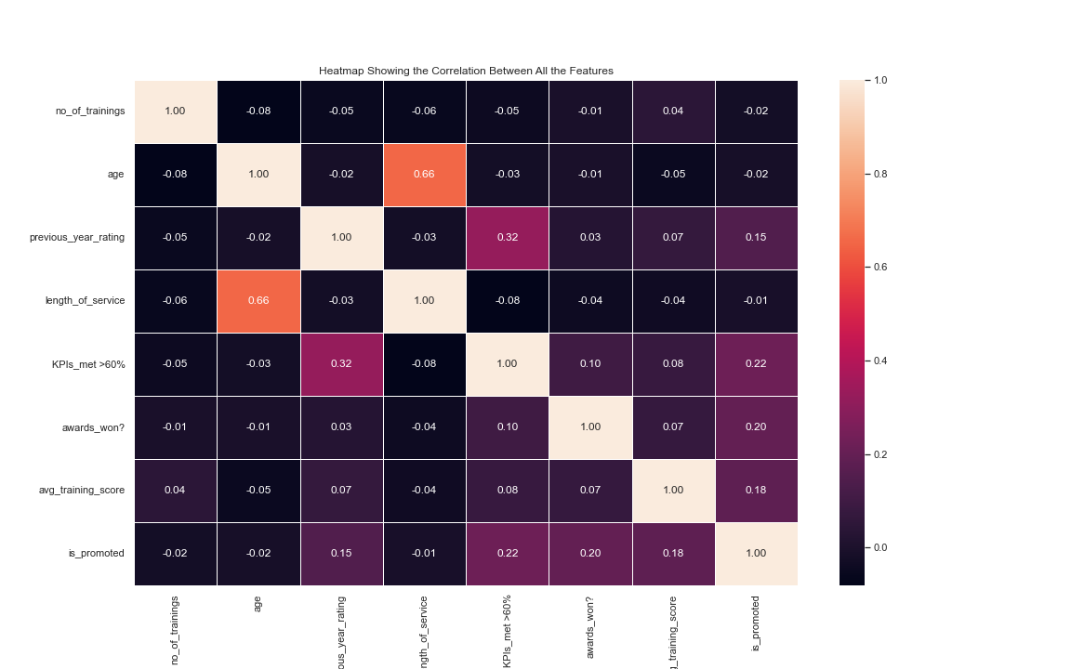

Slide 11
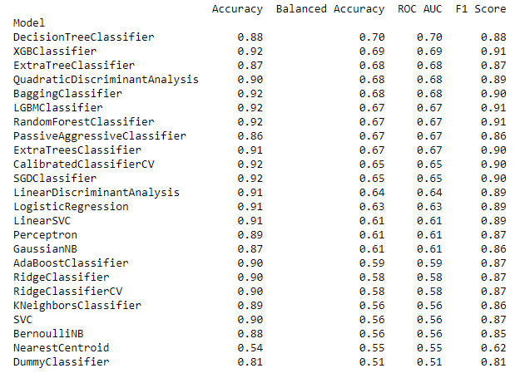
Model Training

Slide 12
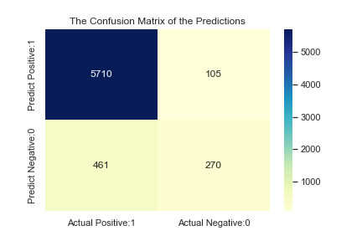
Model Evaluation and Validation

Slide 13
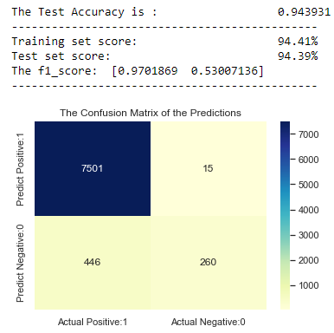
CatBoost Classifier Model

Slide 14
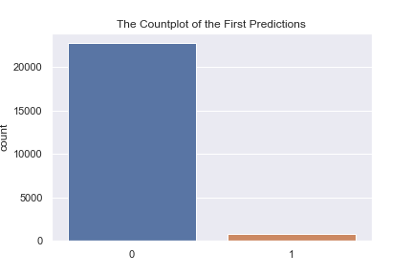

Slide 15
Model Deployment
https://hr-analytics-classification.herokuapp.com

Slide 16
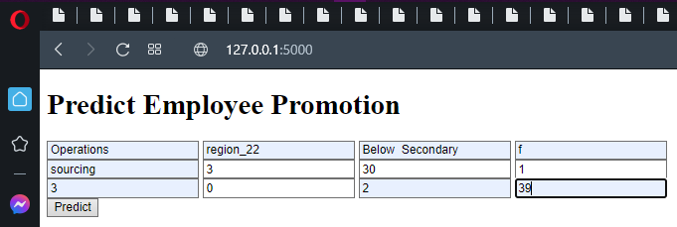
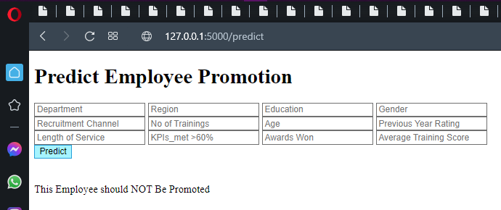
Deployed Demo

Slide 17
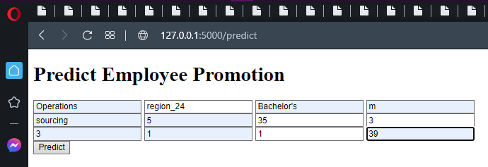
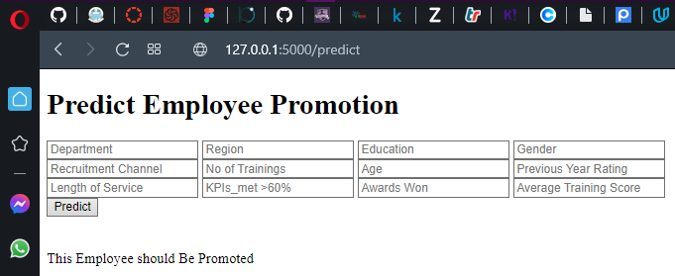
Deployed Demo

Slide 18
Summary and Conclusions
It is clear that CatBoost Classifier Model performed better on the dataset than the other models.

